Slide 1
RFID Tracking and Notification System

Slide 2
Introduction
RFID stands for Radio Frequency Identification.
Microcontroller emits signals to RFID Reader.
Uses Radio Frequency to detect objects.
Reader and Tags.
Active and Passive Device
Better than barcode scanner.

Slide 3
Problem
Parents are not getting information about their children when they are in school.
Sometimes students might not reach to school because of some criminal acts like kidnapping.
Calling to parents of every absent student is time consuming.

Slide 4
Solution
RFID Tag attached student identity card.
Sending Notification when student enter into school.
Filtering of absent student and sending notification.

Slide 5
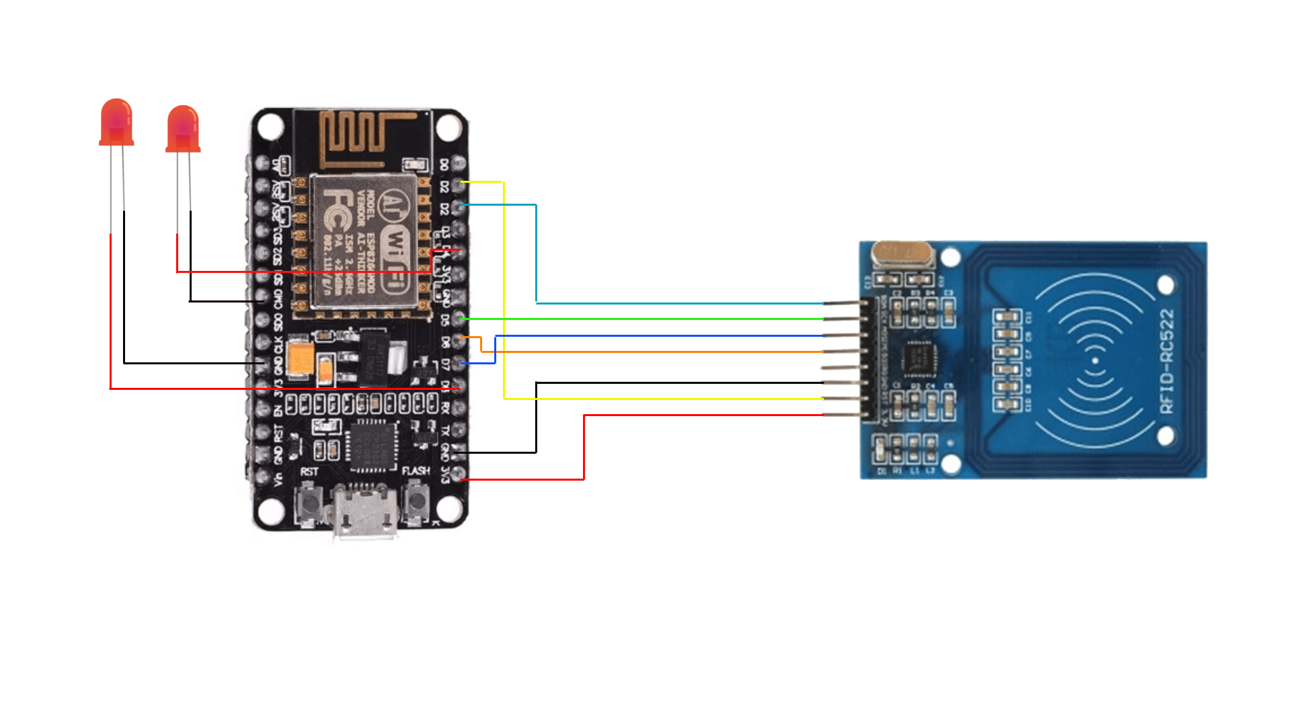
Circuit Diagram

Slide 6
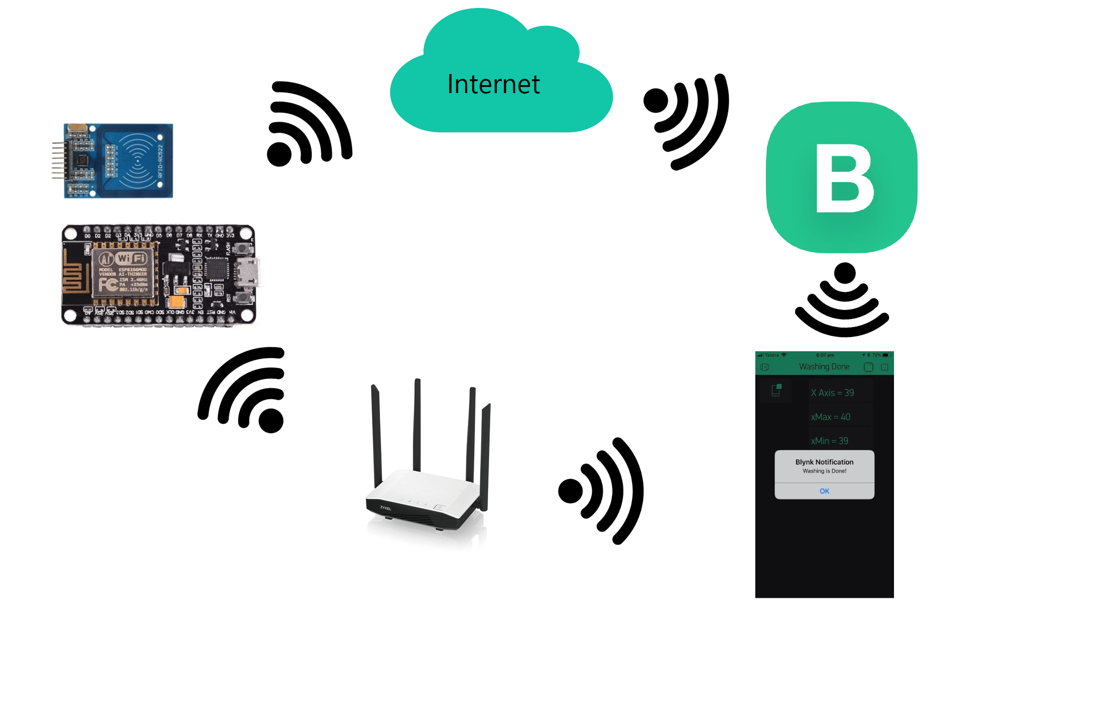
Working

Slide 7
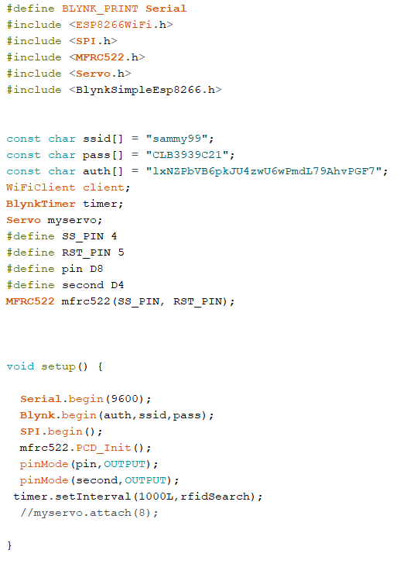
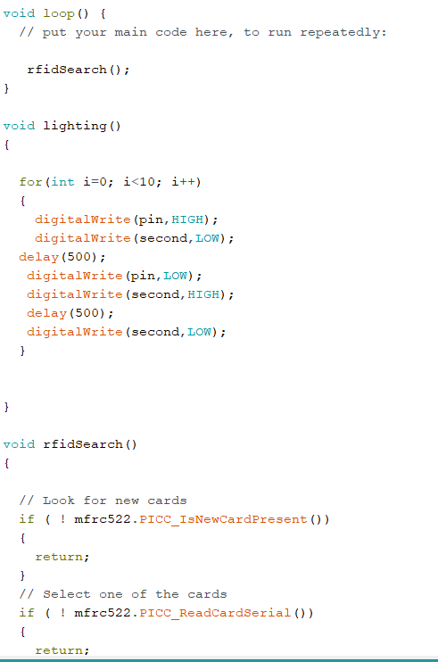
Code

Slide 8
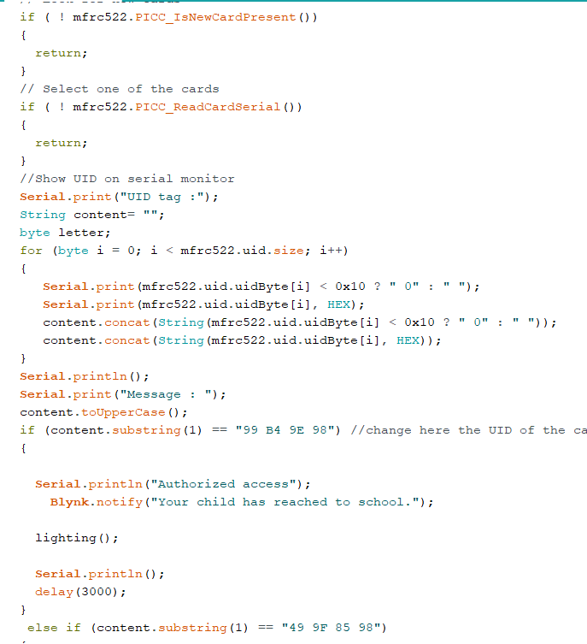
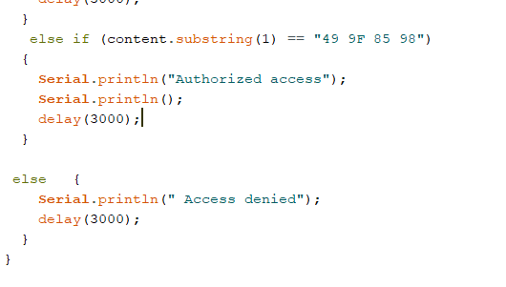

Slide 9
Future Work
Database implementation.

Slide 10
Any Questions?

Slide 11
Thank you☺

